Slide 1
HYPERSPECTRAL IMAGE SEGMENTATION AND ANALYSIS TOWARDS AUTOMATED NON-DESTRUCTIVE MEASUREMENTS OF OLIGOSACCHARIDES AND OTHER TRAITS
Segmentation

Slide 2
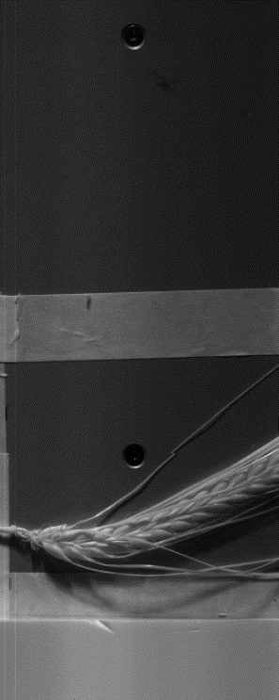
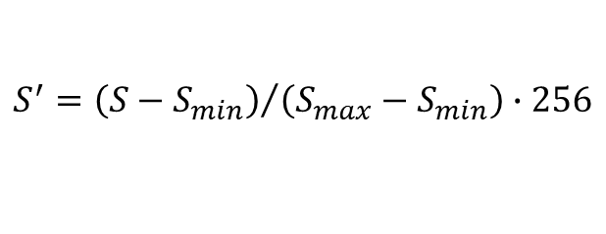

Grayscale Representation
Variable Transformation
For Representation Purpose
$$S^{′}={\left(S−S_{min}\right)}/{\left(S_{max}−S_{min}\right)∙256}$$

Slide 3
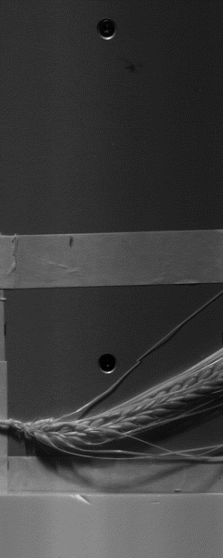
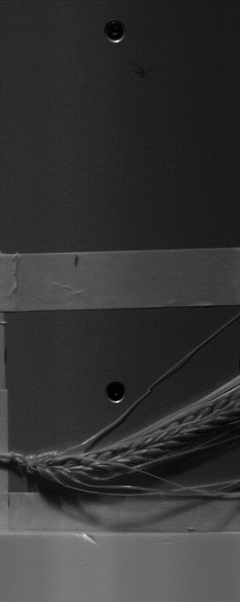
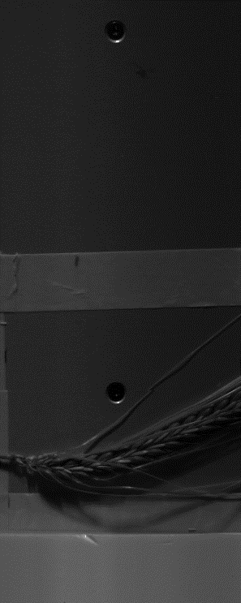
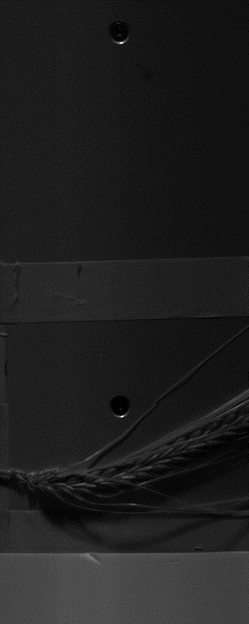
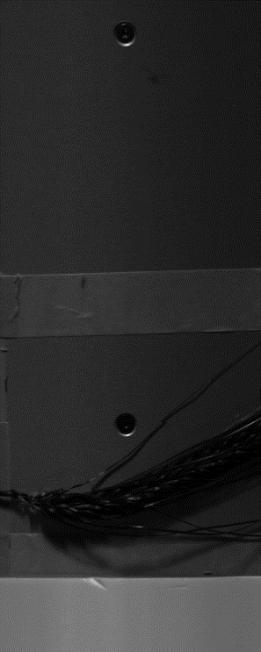
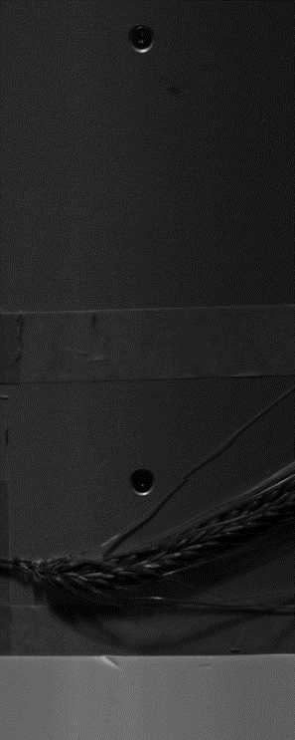
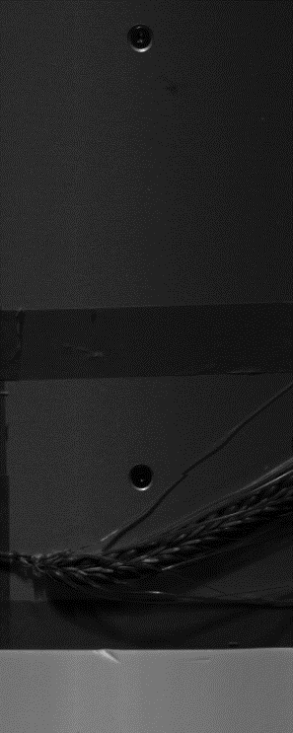
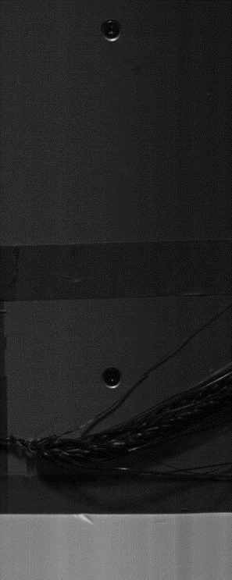
Which Wavelengths?
e.g. SWIR with 256 bands
1 32 64 96 128 160 192 224 256

Slide 4

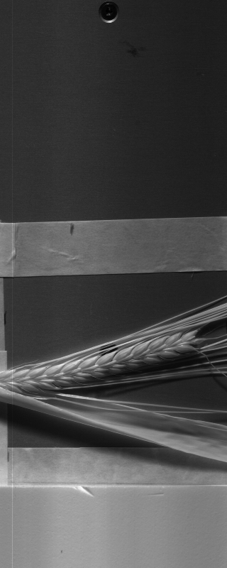
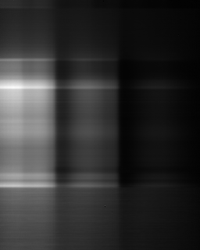
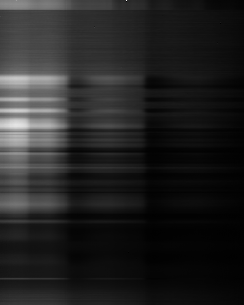
Leaves spectrum vs grains spectrum
0
256
0
256
0
256

Slide 5


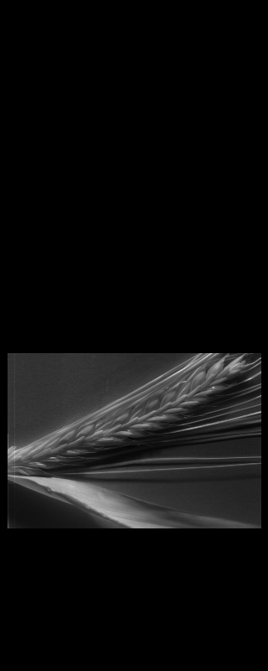


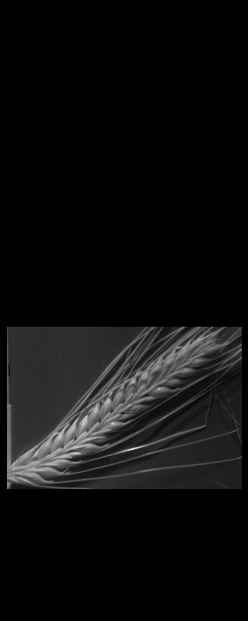

Results based on single channel
Some approaches
Global thresholding (difference between first and last channels)
Quadratic transformation of values to make threshold value selection easier

Slide 6
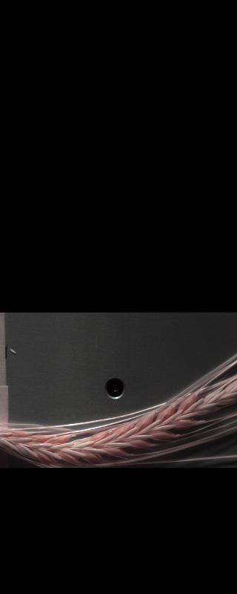
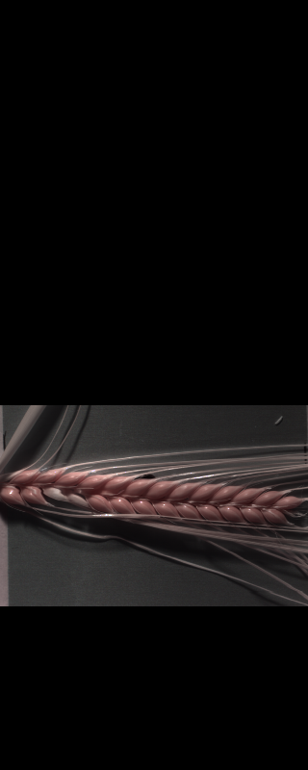
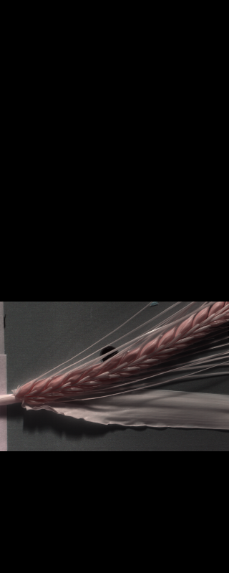
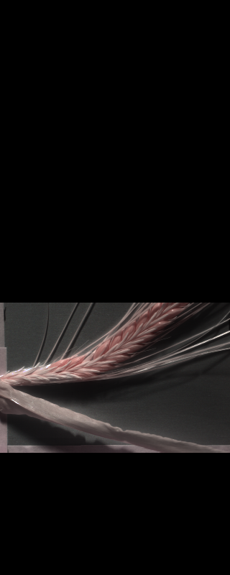
Using three Channels (SWIR)
Only region where spikes located are kept for processing
Channels used: 55, 41, 12
Still many other combinations possible maybe with better result

Slide 7
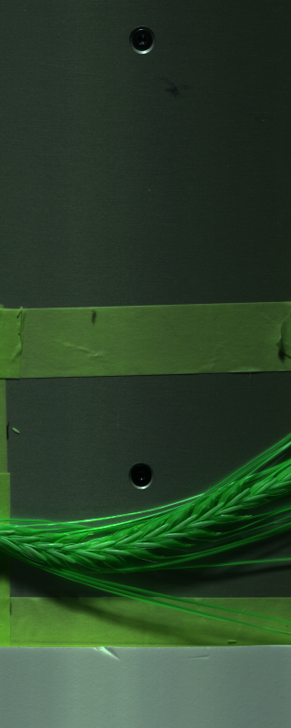
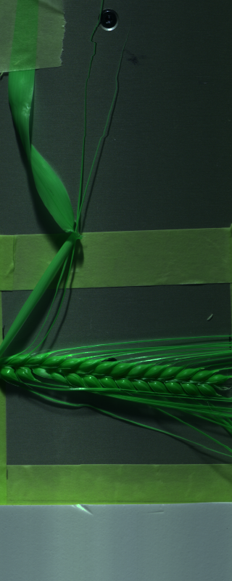
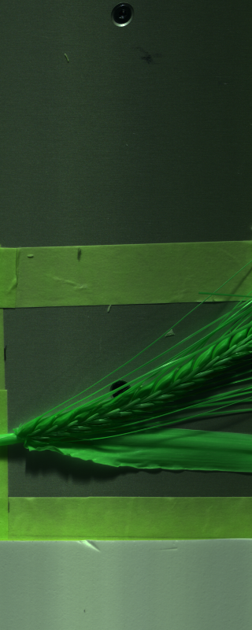
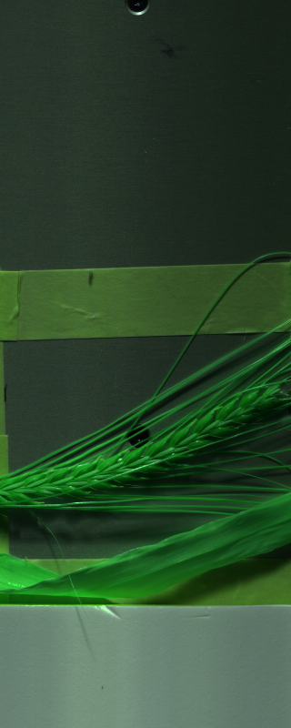
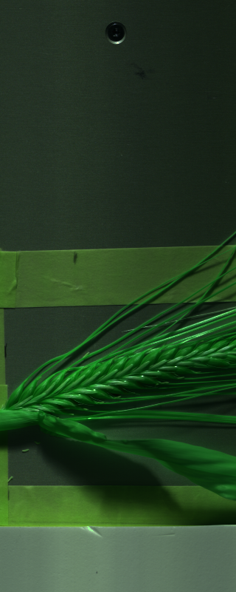
SWIR Recommended Channels in header file 80th, 200th and 48th

Slide 8

Segmentation Using OpenCV
Changing Color-space
Color Conversion
We use the function cv2.cvtColor(input_image, flag) where flag determines the type of conversion (e. g. cv2.COLOR_BGR2HSV).
Applying mask
We use the function cv2.inRange(HSV_converted_image, lower_bounds, upper_bounds)
For HSV, Hue range is [0,179], Saturation range is [0,255] and Value range is [0,255]. Different softwares use different scales. So need to normalize these ranges.

Slide 9
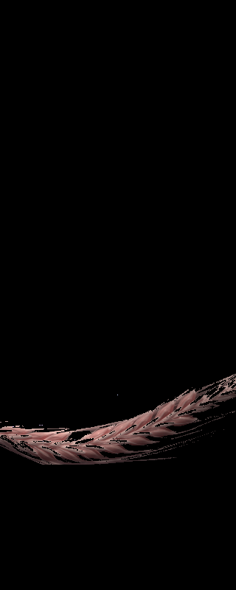
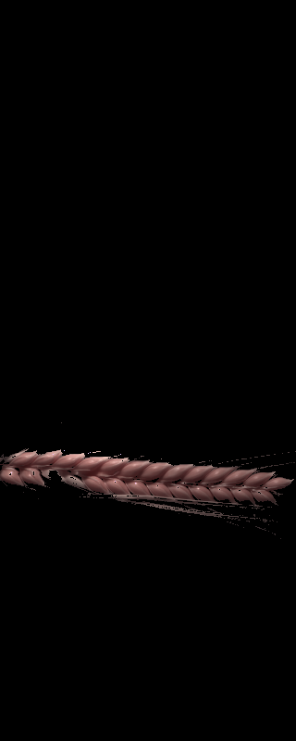



Result of applying Mask
For HSV, Hue range is [0,179], Saturation range is [0,255] and Value range is [0,255]
lower_bounds
(0, 60, 50)
upper_bounds
(100, 255, 255
Leaves removed

Slide 10
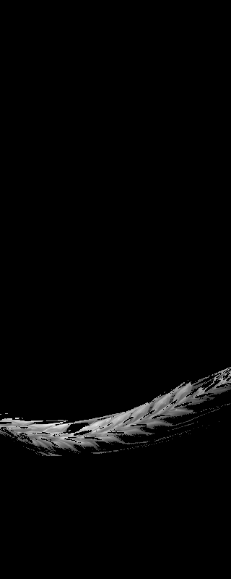
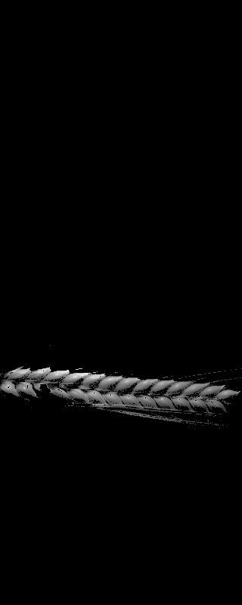
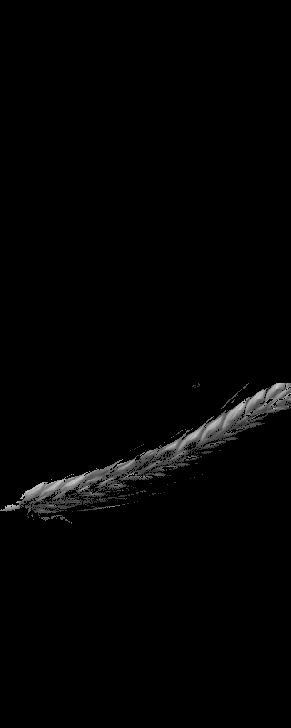

Keeping only single channel
Still it contains noises around grains

Slide 11

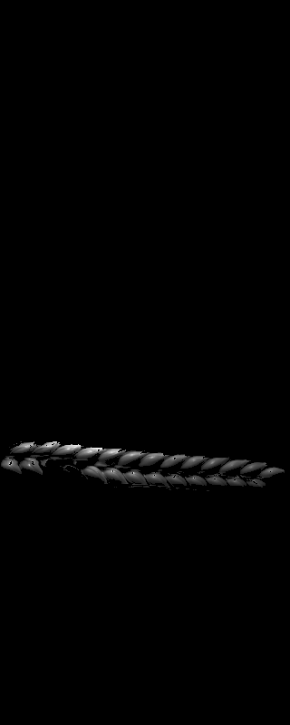


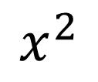
Variable Transformation
Goal:
keep grains well separated
Approach:
Quadratic transformation
pushing back to the range of 0-255
Pros:
can pick a global threshold easier
$$x^{2}$$

Slide 12
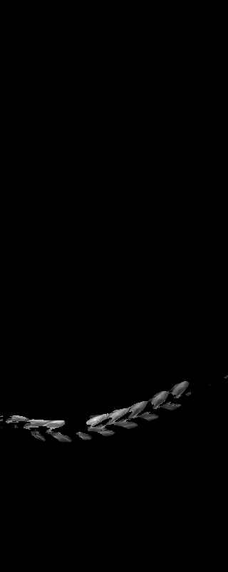
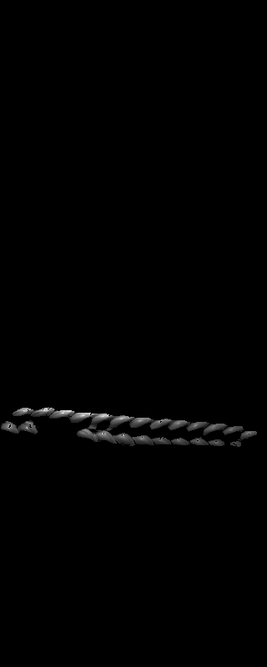
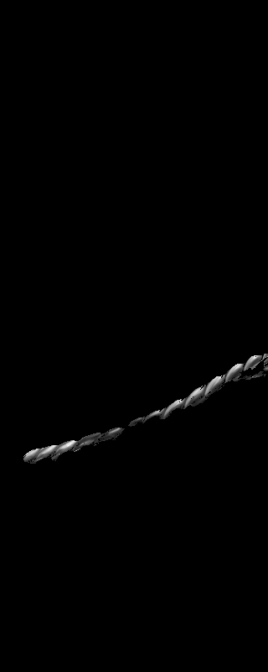

Removing Noises: structuring element
Radius = 5
Minimum points = 50
Radius is based on Moore neighborhood
For any pixel, if the number of neighbors being equal or larger than minimum points (50), its kept otherwise its value is changed to zero.

Slide 13
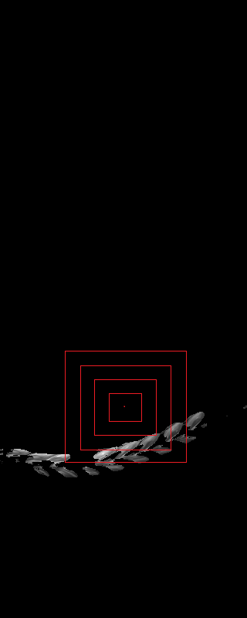
Pick Grains from middle of Spike
started from middle point of area where spikes are located and expanded its area until we cover 2000 pixels
Each grain consist of around 20 X 20 pixels

Slide 14

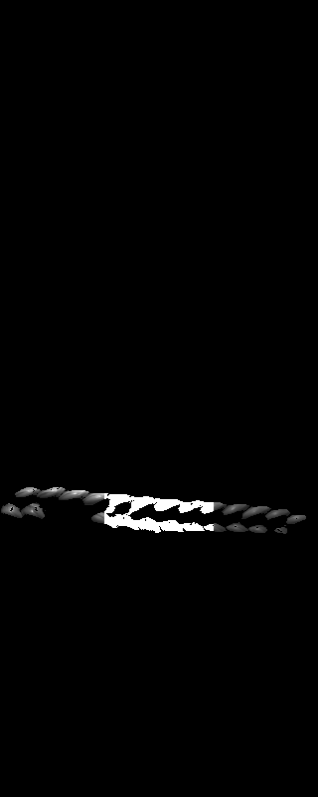
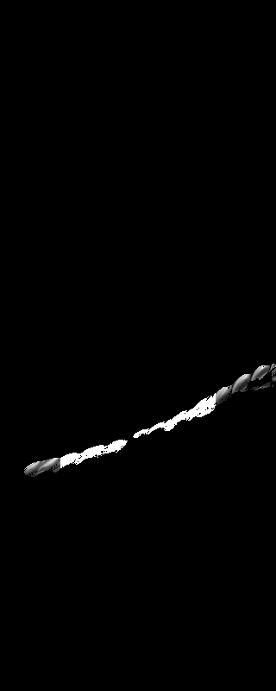

Pick Grains from middle of Spike

Slide 15
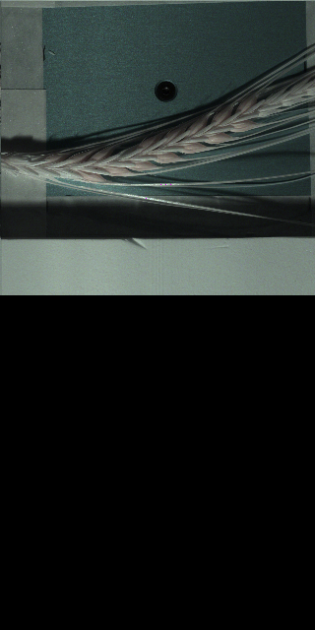
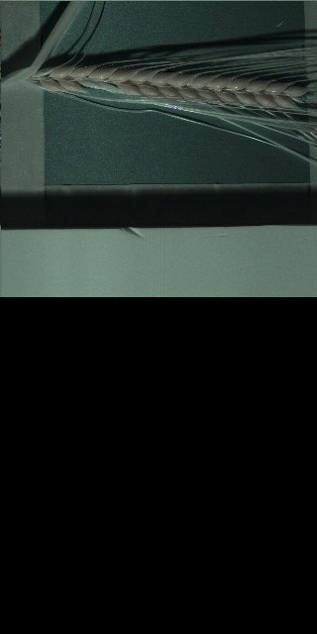
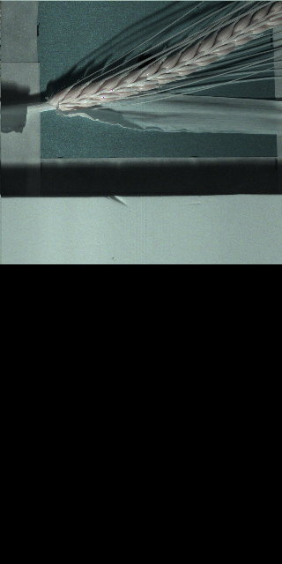
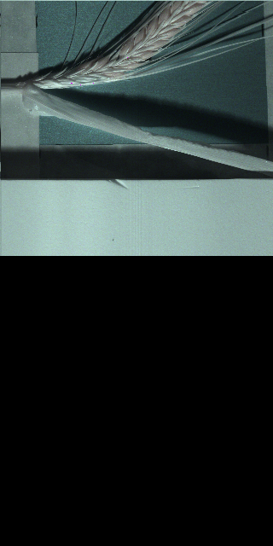
VNIR images
1600 x 3200
Three channels: 159, 152, 120
Only area where spikes are located are kept for processing

Slide 16
Resize VNIR
1600 x 3200
320 x 640
Mean
Median
High computation
Take less amount of time
More than 30 min for single image (i5, 8GB ram)
Around 3 min

Slide 17

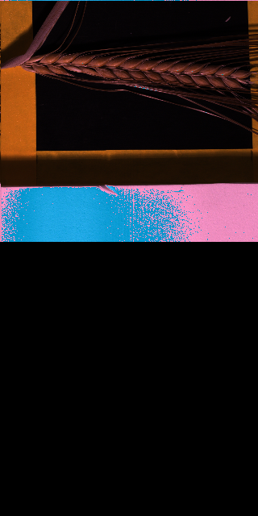
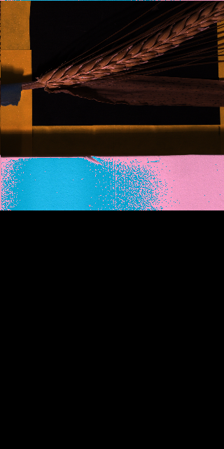
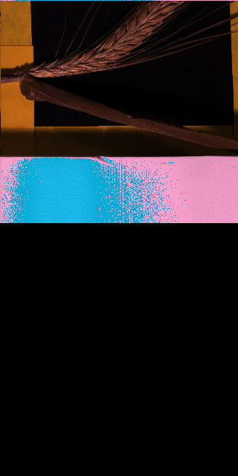
VNIR images
320 x 640
Three channels: 23, 31, 39
Only area where spikes are located are kept for processing

Slide 18
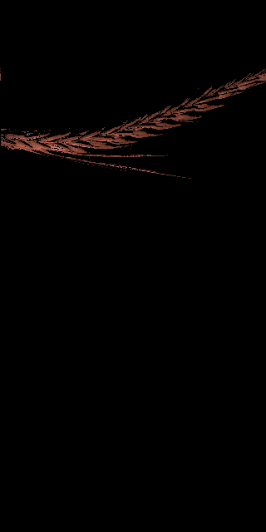



After Applying Mask
lower_bounds:
(0, 0, 80)
upper_bounds:
(10, 250, 255)

Slide 19




Keeping only single channel

Slide 20

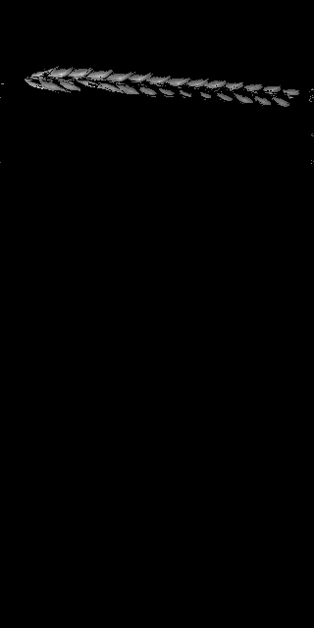
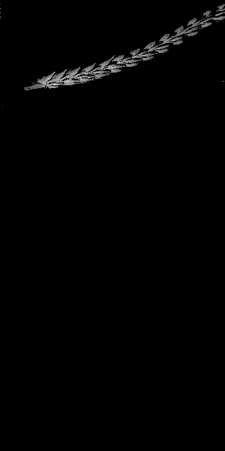

Removing Noises: structuring element
Radius = 5
Minpoints = 20
Iterations: 2

Slide 21

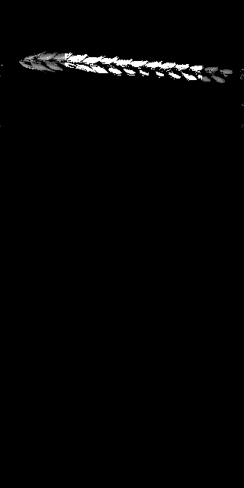


Keeping Middle grains of Spike

Slide 22
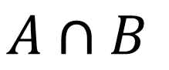
Comparing both Images
$$A∩B$$
Will result around 1000 variables
Is it sufficient?

Slide 23
Comparing both Images
$$A∩B$$
Will result around 1000 variables
Is it sufficient?

Slide 24
Comparing both Images
$$A∩B$$
Will result around 1000 variables
Is it sufficient?

Slide 25
Comparing both Images
$$A∩B$$
Will result around 1000 variables
Is it sufficient?

Slide 26
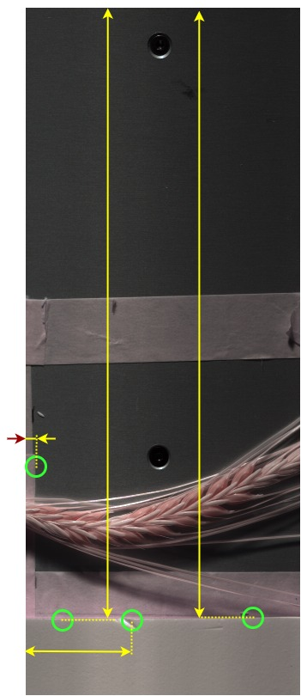

Merging both images
Segmenting four points to merge images such that:
Find starting coordinates for both images
Measure level of zooming
Measure rotation if there be any

Slide 27
Dataset (based On Mean, St.dv)
Img_Name | Channel_no | Mean | std.dev | T_01 | … | T_N
Img001 | 1
Img001 | …
Img001 | 416
…
…
Img460 | 1
Img460 | …
Img460 | 416

Slide 28
Second Dataset (Merging SWIR and VNIR based on coordinates)
Img_Name | X | Y | Ch_001 | Ch_002 | … | Ch_416 | T_01 | … | T_N
Img001
Img001
Img001
Img001
Img001
Img001
…
Img460
Img460
Img460
Img460
Img460
Img460

Slide 29
Project Status
Tasks | Expected Date | Done | Assigned to
Literature Research | 12.Dec.2019 | Yes | All team members
Segmentation | 01.Mar.2020 | Yes | Saied
Management of Data (downloading images and resizing VNIR images) | 05.Mar.2020 | Yes | Ramkishore
Merging images | 10.Mar.2020 | Yes | Saied
Preparing Dataset | 15.Mar.2020 |  | Saied
AI model 1 (based separate data sets of each SWIR and VNIR images) | 01.Apr.2020 |  | Amit, Ramkishore,
AI model 2 (based on mean and std.dev of merged SWIR and VNIR) | 01.Apr.2020 |  | Devish, Sudheer
AI model 3 | 01.Apr.2020 |  | Saied
AI model 3 | 01.Apr.2020 |  | Raman
Comparing Algorithms | … |  | Saied, Amit, Raman
Documentation | … |  | Amit, Raman, Ramkishore, Sudheer, Devish

